Slide 1




Slide 2

ENSE 281 GROUP PROJECT
Project Description: Design & Develop A Small To Medium Scaled, Web-Based Software Application
WINTER 2026 - GROUP E
Ali Abdullah
Nyabijek Gatdet
Chiemego Emmanuel
Chinedu Godswill

Slide 3


Slide 4


PROJECT STATUS
Current Status: Yellow
• Partial implementation of designs & logics.
• Bargain feature is still under development.
• Worker dashboard showing gig categories but not access yet.
• System unable to classify the on spot and scheduled gigs.
• Logics / implementations getting failed or mismatched.
• Removal of worker accepting or rejecting gig due to code flaws.
Major Issues
• Some deliverables still in early stages, slowing integration.
• Insufficient skills due to more material and less practice.
• Time management due to personal life and academic workload.

Slide 5


THE BUILD – PAST WEEKS
Completed core authentication components for dual portal system access and display.
Established structural layouts for all pages, except the conversations.
Began developing the gig marketplace; posting and browsing layouts.
Initiated planning and design for bargaining opportunity.
Improved layout efficiency and visual design across multiple pages.
Removed multiple menu options and limited to 4, making one as a log out button.
Learning different things like animations over the internet to make project desirable.
Constant changes in logic implementation due to multiple run failures.

Slide 6
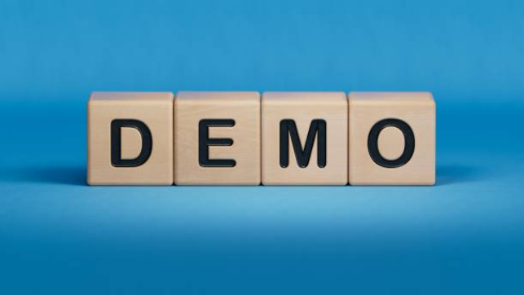

Slide 7


THE PLAN – FUTURE WEEKS
Expand functionality of the gig marketplace (posting, browsing, accepting, rejecting, bargaining).
Develop the bargain system along with communication means (conversations between both parties to decide budget).
Finalize menu options for both workers and customers (limited options but useful, like self-profile, view ratings, chat support etc.).
Begin implementation and testing between all system components and connections (no bugs and failures expected)

Slide 8


SELF REFLECTION
Feelings about activity:
Way more complicated than previous activities , Almost there.
Most liked part:
Learning animations in coding , Working of codes altogether.
Least liked part:
Coding conflicts , Keeping pages integrated.
Proud about project:
Learning to be on the same page , Countless efforts , Improvement.
Lessons learned:
Give your best , Do not stress a lot , Patience is the key.
Experience going forward:
Do not take time for granted , Stay connected frequently.
Help needed further:
Practice & enhance coding skills , Manage time efficiently.

Slide 9

Any Questions?
Any Suggestions?
Any Specifications?
Any Recommendations?

Slide 10




